Slide 1


Topic-Rumor
NATIONAL INSTITUTE OF TECHNOLOGY, SILCHAR
Detection
Guided By –
Dr. Anupam Bishwas
Presented By - Shiva Agarwal
Notes:
To use this title animation slide with a new image simply 1) move the top semi-transparent shape to the side, 2) delete placeholder image, 3) click on the picture icon to add a new picture, 4) Move semi-transparent shape back to original position, 5) Update text on slide.

Slide 2


What are rumors ???
“ Rumor is a piece of news or information that many people are talking about but that is possibly not true”
“A tall tale of explanations of events circulating from person to person and pertaining to an object, event, or issue in public concern."

Slide 3
CONTENTS
Different methods and prediction
Logistic Regression
Decision Tree Classification
Gradient Boosting Classifier
Random Forest Classifier
Problem Overview
Automatic rumor detection is technically very challenging. In this work, we try to learn discriminative features from tweets content by following their non-sequential propagation structure and generate more powerful representations for identifying different type of rumors.
Drawback and improvement
LSTM- It is special kind of recurrent neural network that is capable of learning long term dependencies in data. This is achieved because the recurring module of the model has a combination of layers interacting with each other.
What new in it?

Slide 4


HUMAN ARE ALSO CONFUED?
Why Fake News Detection is Tough
?
Fake News also becomes more challenging as social media continues to dominate our everyday lives and hence accelerating the speed of which Fake News travel.
In a recent study published by the journal Science, it analysed millions of tweets sent between 2006 and 2017 and it was found that: “Falsehood diffused significantly farther, faster, deeper, and more broadly than the truth in all categories of information.”
It also concluded that “it took the truth about six times as long as falsehood to reach 1,500 people.”

Slide 5

Different Type of Fake News
?
Claire Wardle of First Draft News identifies seven types of fake news:
satire or parody ("no intention to cause harm but has potential to fool")
false connection ("when headlines, visuals or captions don't support the content")
misleading content ("misleading use of information to frame an issue or an individual")
false context ("when genuine content is shared with false contextual information")
impostor content ("when genuine sources are impersonated" with false, made-up sources)
manipulated content ("when genuine information or imagery is manipulated to deceive", as with a "doctored" photo)
fabricated content ("new content is 100% false, designed to deceive and do harm")

Slide 6
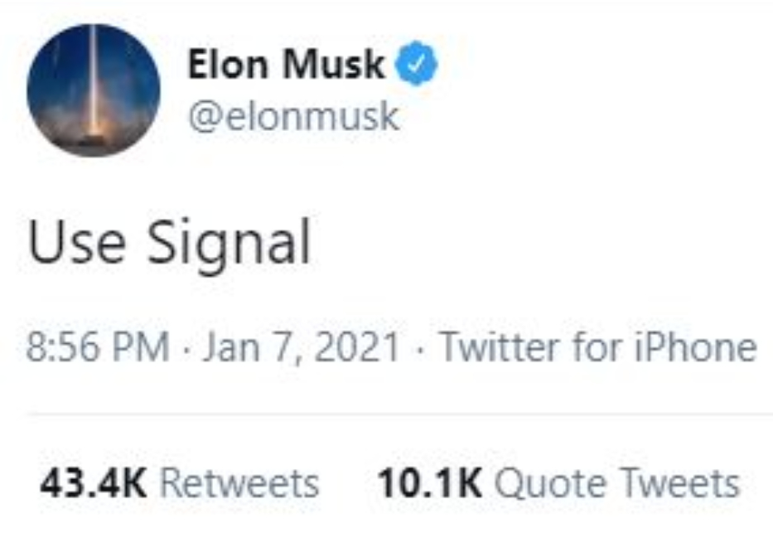
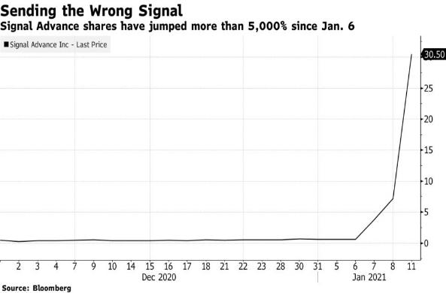
Fake News Detection
?
The International Federation of Library Associations and Institutions (IFLA) published a summary in diagram form to assist people in recognizing fake news. Its main points are:
Consider the source (to understand its mission and purpose)
Read beyond the headline (to understand the whole story)
Check the authors (to see if they are real and credible)
Assess the supporting sources (to ensure they support the claims)
Check the date of publication (to see if the story is relevant and up to date)
Ask if it is a joke (to determine if it is meant to be satire)
Review your own biases (to see if they are affecting your judgment)
Ask experts (to get confirmation from independent people with knowledge)

Slide 7
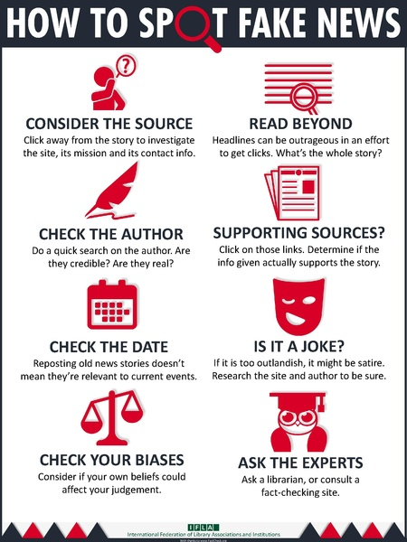
International Federation of Library Associations and Institutions (IFLA) published a summary in diagram form to assist people in recognizing fake news.
Notes:
Combine an image and multiple key statements with a strong grid.

Slide 8

IMPACT OF RUMOR
Financial impacts or impacts on my health
Bullying and violence against innocent people
Fear
Democratic impacts
Racist ideas

Slide 9
PREPARE DATA
Collect Training Dataset and Data Preprocessing
Dataset from Kaggle link :- https://www.kaggle.com/c/fake-news/data
DATA REDUCTION
Due to our machine capability is limited so we are working on less data and also selection required attributes of computation.
DATA TRANSFORMATION
We are performing Normalization to our data and check the attributed required for computation.
DATA CLEANING
We are checking missing values and verify that our dataset. Removing noisy data.

Slide 10
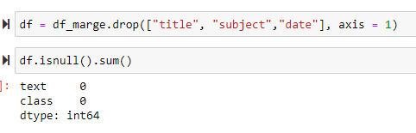

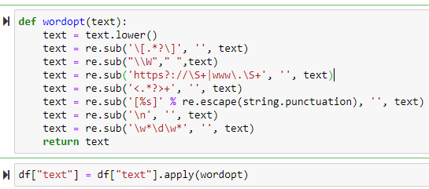
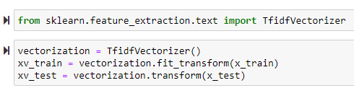
USING PYTHON FOR
PROCESSING OF DATA
DATA
PROCESSING
DROPING ROWS NOT IN USE
REMOVING SPECIAL CHARACTERS
CONVERTING TEXT TO VECTORES

Slide 11

DIFFERENT MTEHODS WE ARE USING AND WORKING ON.
1
2
3
4
5
Logistic Regression
Decision Tree Classification
Gradient Boosting Classifier
Random Forest Classifier
LSTM -Long Short-Term Memory

Slide 12
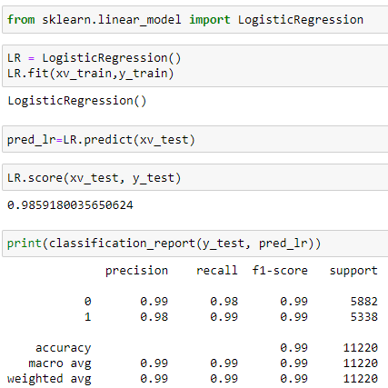
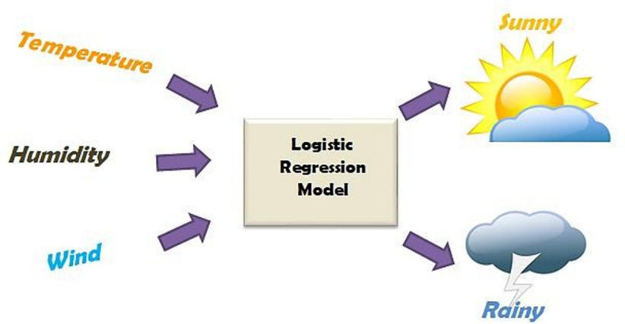
LOGISTIC REGRESSION
Logistic regression is a statistical model that in its basic form uses a logistic function to model a binary dependent variable, although many more complex extensions exist.

Slide 13
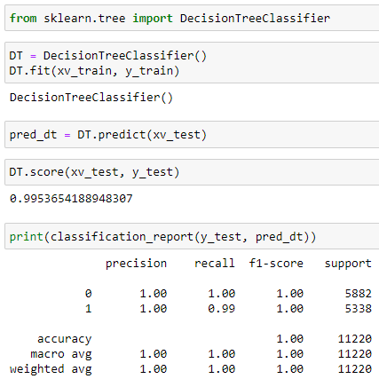
Decision tree
A decision tree is a decision support tool that uses a tree-like model of decisions and their possible consequences, including chance event outcomes, resource costs, and utility. It is one way to display an algorithm that only contains conditional control statements.
NEWS
FAKE NEWS
TRUE NEWS

Slide 14
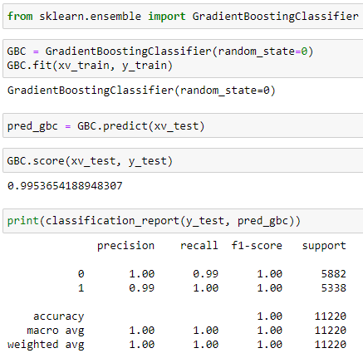
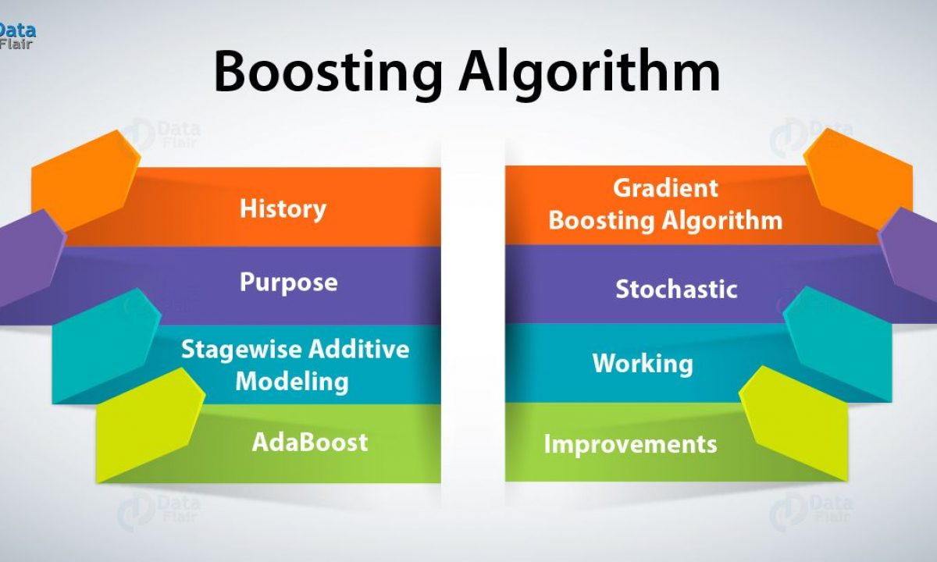
Gradient Bosting technique
Gradient boosting is a machine learning technique for regression and classification problems, which produces a prediction model in the form of an ensemble of weak prediction models, typically decision trees.

Slide 15
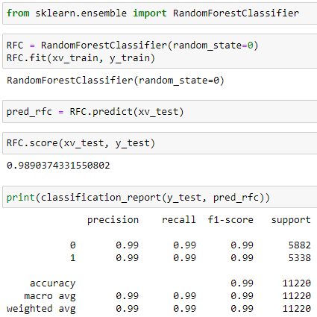
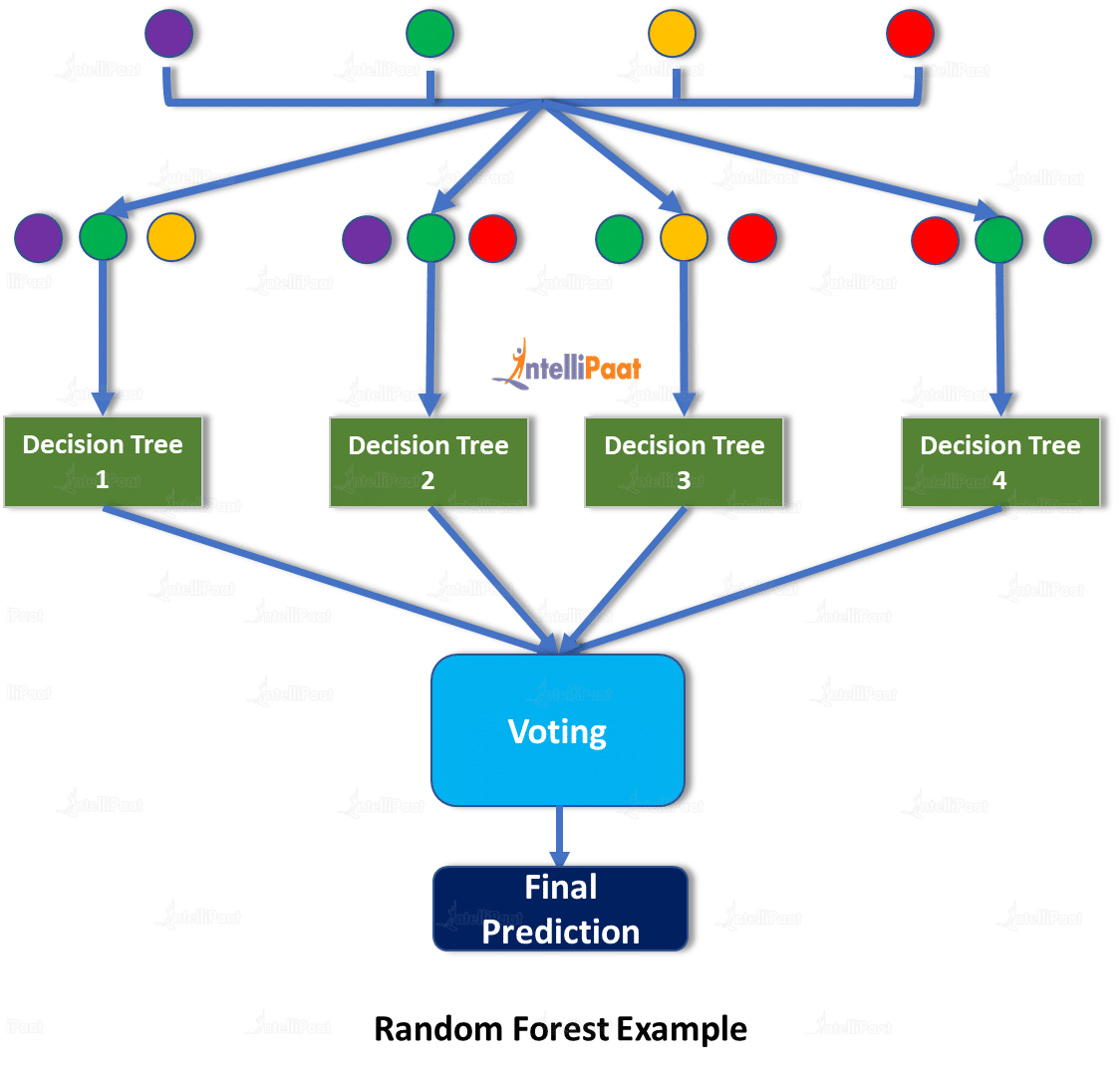
Random forest classifier
A random forest is a meta estimator that fits a number of decision tree classifiers on various sub-samples of the dataset and uses averaging to improve the predictive accuracy and control over-fitting.

Slide 16
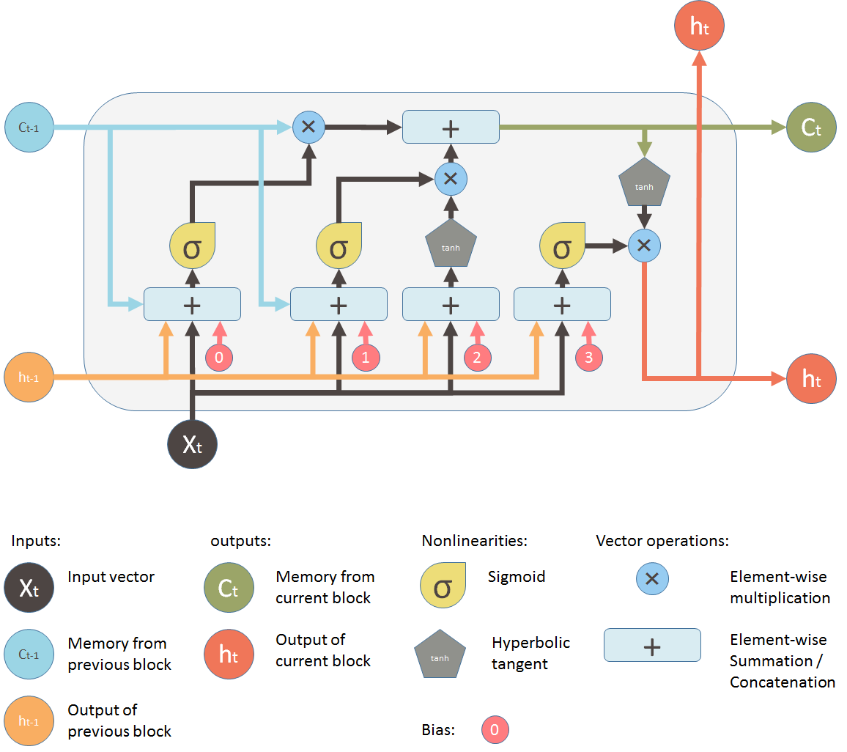
LSTM - Long Short-Term Memory
Humans don’t start their thinking from scratch every second. As you read this essay, you understand each word based on your understanding of previous words. You don’t throw everything away and start thinking from scratch again. Your thoughts have persistence. Long Short Term Memory networks – usually just called “LSTMs” – are a special kind of RNN, capable of learning long-term dependencies.
Notes:
Tip:
When using complex image as full-bleed background add a transparency (70%-90%) fill layer to give contrast to text.

Slide 17
Automatic Rumor Detection Advantages
Fake news has altered society in negative ways in politics and culture. It has adversely affected both online social network systems as well as offline communities and conversations. Using automatic machine learning classification models is an efficient way to combat the widespread dissemination of fake news.
A multimodal system with the aim to differentiate between fake and real posts. Our system is based on a neural network and combines textual, visual and semantic information. The textual information is extracted from the content of the post, the visual one from the image that is associated with the post and the semantic refers to the similarity between the image and the text of the post.

Slide 18

THANK YOU FOR YOUR ATTENTION!
ANY
QUESTION?

Slide 19
References
23rd International Conference, TSD (Text, speech and dialogue) 2020 Brno, Czech Republic, September 8–11, 2020 Proceedings springer chapter link https://link.springer.com/chapter/10.1007/978-3-030-58323-1_3 Multimodal Fake News Detection with Textual, Visual and Semantic Information Anastasia Giachanou1(B) , Guobiao Zhang1,2, and Paolo Rosso1 1 Universitat Polit`ecnica de Val`encia, Valencia, Spain angia9@upv.es, prosso@dsic.upv.es 2 Wuhan University, Wuhan, China zgb0537@whu.edu.cn LSTM-Based Speech Segmentation Trained on Different Foreign Languages Zdenˇek Hanzl´ıˇcek(B) and Jakub V´ıt NTIS - New Technology for the Information Society, Faculty of Applied Sciences, University of West Bohemia, Univerzitn´ı 22, 306 14, Plzeˇn, Czech Republic {zhanzlic,jvit}@ntis.zcu.c

